Slide 2




Mathematics Department
Week 3 (Nov 17-20)
Topic 1 – GCF, HCF AND RATIOS

Slide 3


Wellbeing
Essential question : How can we use integers to solve real-life problems accurately?

Slide 4
Lesson Cycle
Engage
(Let's start to think, pre assessment)
Explore
(Search, look for and share ideas)
Explain
(Listen to the teacher carefully
Extend
((Time to collaborate and participate and try it by yourself)
Evaluate
(End of lesson Assessment)

Slide 5


Slide 6
Period 1

Slide 7
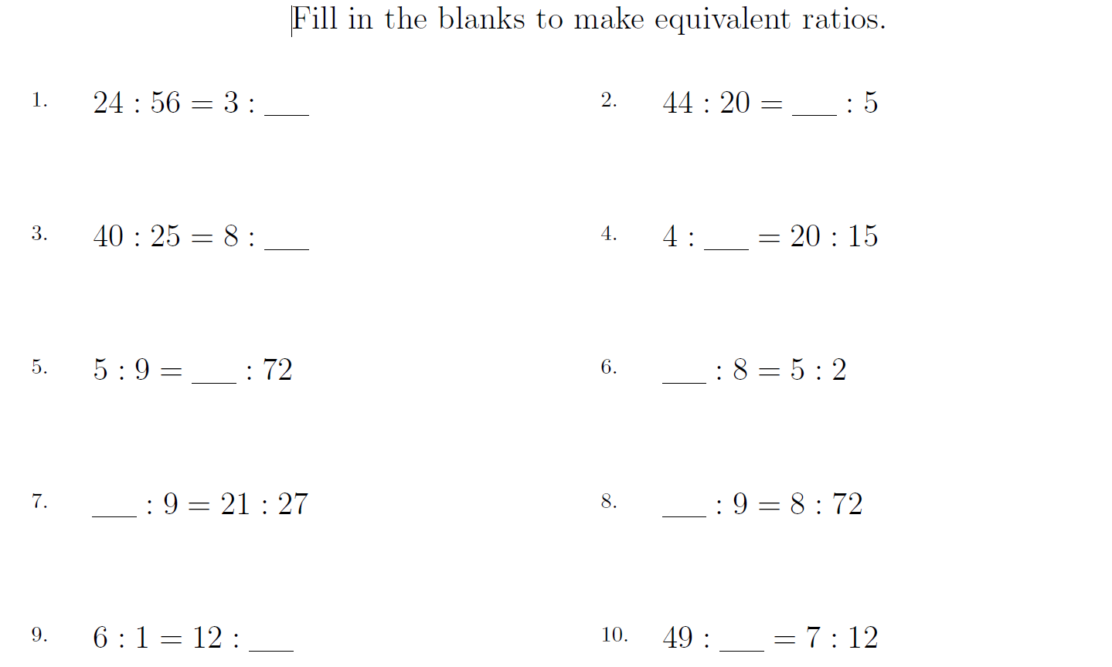
RATIOS

Slide 8
RATIO
The quantitative relation between two amounts showing the number of times one value contains or is contained within the other:
EXAMPLES
"the ratio of computers to students is now 2 to 1"
"the ratio of average prices to average salaries is at its lowest number for years"

Slide 9



RATIO
Lesson Objective: I will be able to compute unit rates involving ratios of fractions by dividing and simplifying fractions.
SC : I can write a ratio of fractions as a complex fraction.
SC : I can divide fractions to find the unit rate.
UAE LINK : Find examples of unit rates in UAE.
Teacher Link: https://wayground.com/admin/activity/classic/68ec96746174557f184084a1
ATL SKILLS : COMMUNICATION
IB LEARNER PROFILE : COMMUNICATOR
Keywords: Ratio, unit rate, reciprocal, simplify

Slide 10
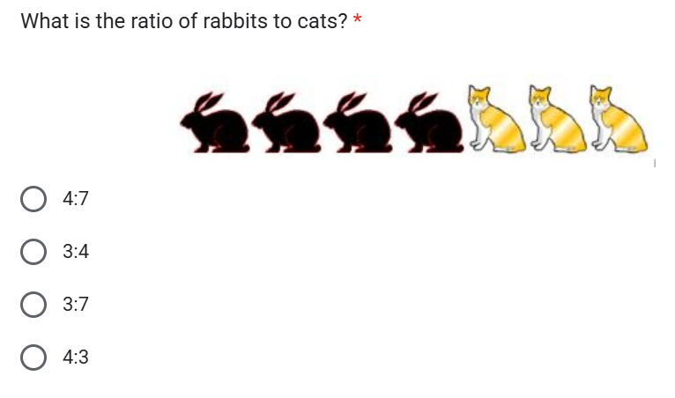
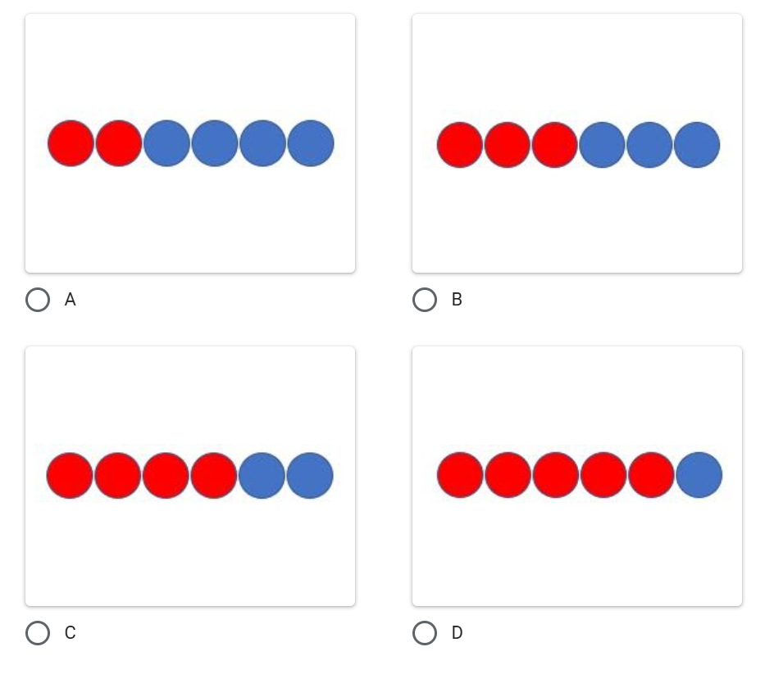
RATIO
Lesson Objective: I will be able to compute unit rates involving ratios of fractions by dividing and simplifying fractions.
SC : I can write a ratio of fractions as a complex fraction
SC : I can divide fractions to find the unit rate
UAE LINK : Find examples of unit rates in UAE.
KNOWLEDGE
Which of the following ratios is 2:1
ATL SKILLS : COMMUNICATION
IB LEARNER PROFILE : COMMUNICATOR
Keywords: Ratio, unit rate, reciprocal, simplify

Slide 11
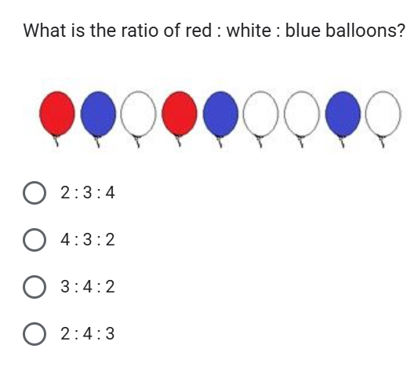
RATIO
Lesson Objective: I will be able to compute unit rates involving ratios of fractions by dividing and simplifying fractions.
SC : I can write a ratio of fractions as a complex fraction
SC : I can divide fractions to find the unit rate
UAE LINK : Find examples of unit rates in UAE.
APPLICATION
ATL SKILLS : COMMUNICATION
IB LEARNER PROFILE : COMMUNICATOR
Keywords: Ratio, unit rate, reciprocal, simplify

Slide 12
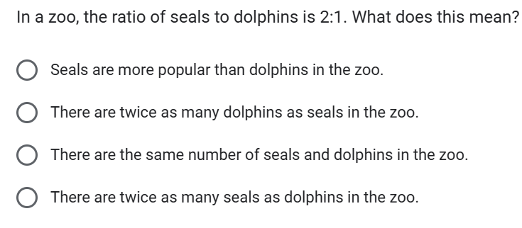
RATIO
Lesson Objective: I will be able to compute unit rates involving ratios of fractions by dividing and simplifying fractions.
SC : I can write a ratio of fractions as a complex fraction
SC : I can divide fractions to find the unit rate
UAE LINK : Find examples of unit rates in UAE.
REASONING
ATL SKILLS : COMMUNICATION
IB LEARNER PROFILE : COMMUNICATOR
Keywords: Ratio, unit rate, reciprocal, simplify

Slide 13
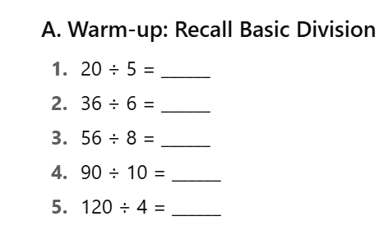
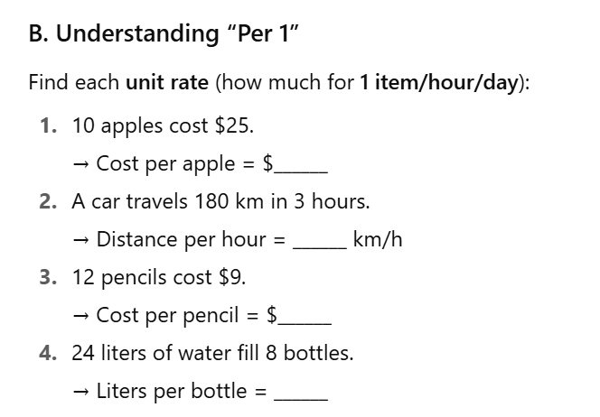
RATIO
Lesson Objective: I will be able to compute unit rates involving ratios of fractions by dividing and simplifying fractions.
SC : I can write a ratio of fractions as a complex fraction
SC : I can divide fractions to find the unit rate
UAE LINK : Find examples of unit rates in UAE.
ATL SKILLS : COMMUNICATION
IB LEARNER PROFILE : COMMUNICATOR
Keywords: Ratio, unit rate, reciprocal, simplify

Slide 14
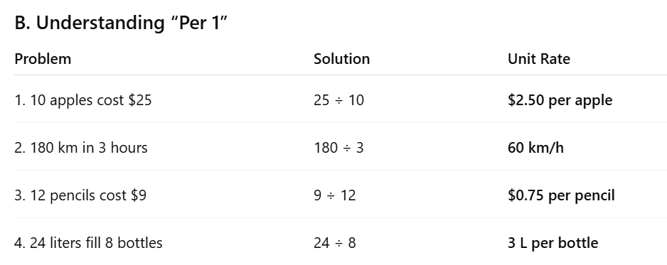
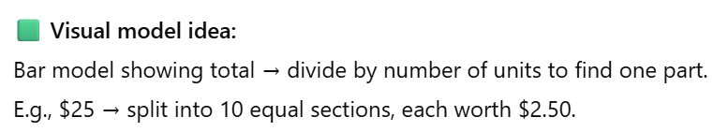
RATIO
Lesson Objective: I will be able to compute unit rates involving ratios of fractions by dividing and simplifying fractions.
SC : I can write a ratio of fractions as a complex fraction
SC : I can divide fractions to find the unit rate
UAE LINK : Find examples of unit rates in UAE.
ATL SKILLS : COMMUNICATION
IB LEARNER PROFILE : COMMUNICATOR
Keywords: Ratio, unit rate, reciprocal, simplify

Slide 15
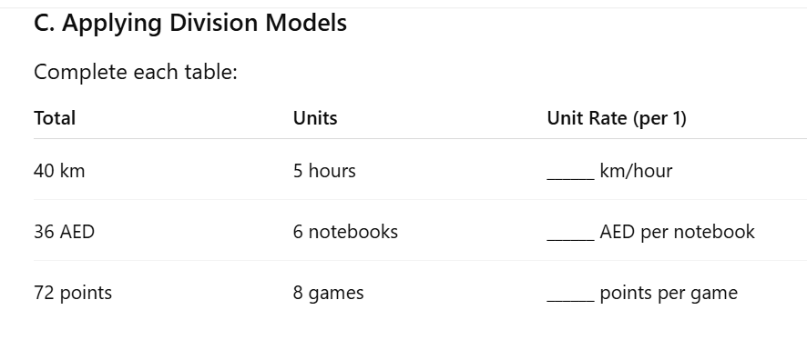
RATIO
Lesson Objective: I will be able to compute unit rates involving ratios of fractions by dividing and simplifying fractions.
SC : I can write a ratio of fractions as a complex fraction
SC : I can divide fractions to find the unit rate
UAE LINK : Find examples of unit rates in UAE.
MINI-PLENARY
DO YOU UNDERSTAND THE KEYWORDS?
DO YOU UNDERSTAND UNIT RATES?
ATL SKILLS : COMMUNICATION
IB LEARNER PROFILE : COMMUNICATOR
Keywords: Ratio, unit rate, reciprocal, simplify

Slide 16
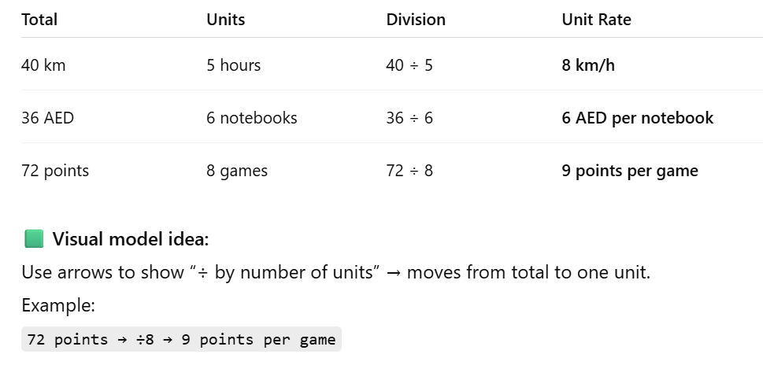
RATIO
Lesson Objective: I will be able to compute unit rates involving ratios of fractions by dividing and simplifying fractions.
SC : I can write a ratio of fractions as a complex fraction
SC : I can divide fractions to find the unit rate
UAE LINK : Find examples of unit rates in UAE.
ATL SKILLS : COMMUNICATION
IB LEARNER PROFILE : COMMUNICATOR
Keywords: Ratio, unit rate, reciprocal, simplify

Slide 17
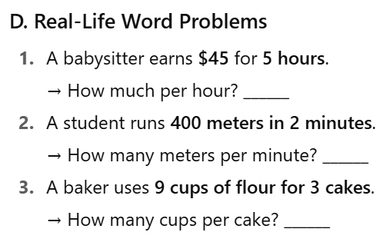
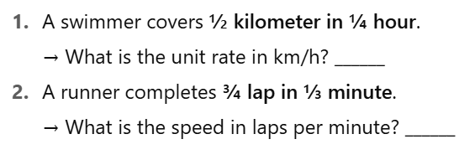
RATIO
Lesson Objective: I will be able to compute unit rates involving ratios of fractions by dividing and simplifying fractions.
SC : I can write a ratio of fractions as a complex fraction
SC : I can divide fractions to find the unit rate
UAE LINK : Find examples of unit rates in UAE.
E : FOR EARLY FINISHERS
ATL SKILLS : COMMUNICATION
IB LEARNER PROFILE : COMMUNICATOR
Keywords: Ratio, unit rate, reciprocal, simplify

Slide 18
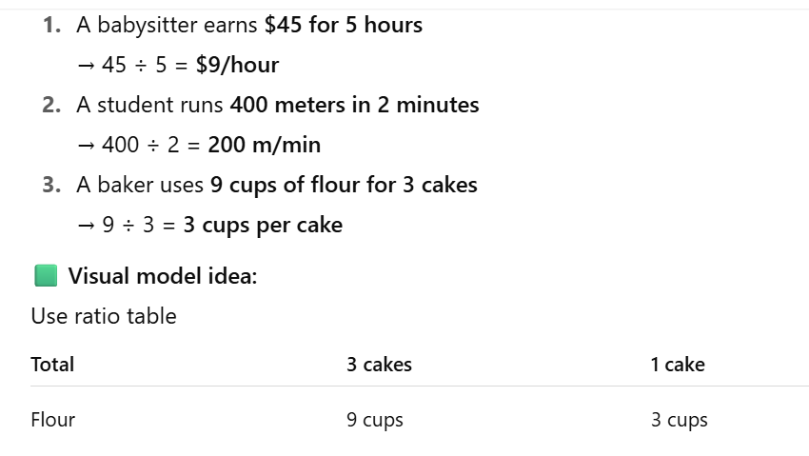
RATIO
Lesson Objective: I will be able to compute unit rates involving ratios of fractions by dividing and simplifying fractions.
SC : I can write a ratio of fractions as a complex fraction
SC : I can divide fractions to find the unit rate
UAE LINK : Find examples of unit rates in UAE.
PART D
ATL SKILLS : COMMUNICATION
IB LEARNER PROFILE : COMMUNICATOR
Keywords: Ratio, unit rate, reciprocal, simplify

Slide 19
RATIO
Lesson Objective: I will be able to compute unit rates involving ratios of fractions by dividing and simplifying fractions.
SC : I can write a ratio of fractions as a complex fraction
SC : I can divide fractions to find the unit rate
UAE LINK : Find examples of unit rates in UAE.
DOK 3 – Strategic Thinking
If the family leaves Fujairah at 3:30 PM and drives at 54 km/h, what time will they arrive in Dubai? Show your reasoning.
Compare the time and speed required for the onward and return trips. Which trip is faster and why?
The car’s fuel efficiency decreases if the speed drops by 10km/h. Explain how driving slower affects fuel consumption and travel time.
DOK 4 – Extended Thinking
Create a table showing distance, speed, travel time, departure, and arrival for both trips.
The family wants to minimize travel time while consuming the least fuel. Suggest an optimal speed for the return trip and justify your answer using calculations.
Imagine there is a traffic delay of 15 minutes on the return trip. Recalculate the required average speed to still arrive by 6:00 PM.
ATL SKILLS : COMMUNICATION
IB LEARNER PROFILE : COMMUNICATOR
Keywords: Ratio, unit rate, reciprocal, simplify

Slide 20
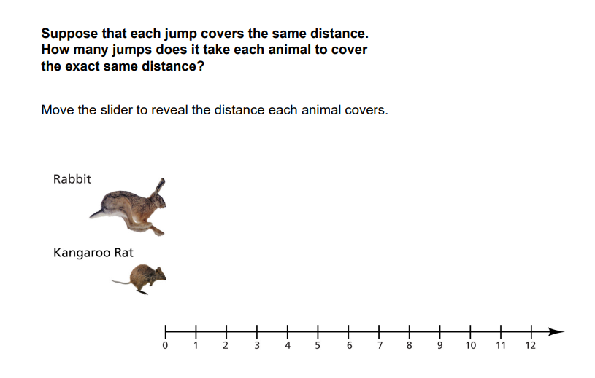
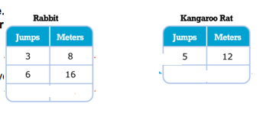
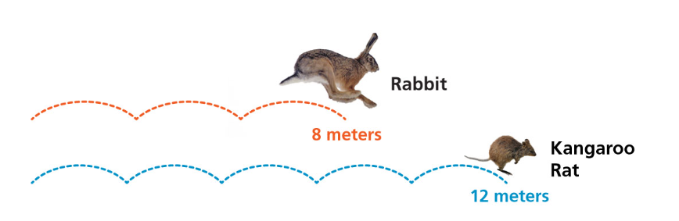
RATIO
Lesson Objective: I will be able to compute unit rates involving ratios of fractions by dividing and simplifying fractions.
SC : I can write a ratio of fractions as a complex fraction
SC : I can divide fractions to find the unit rate.
UAE LINK : Find examples of unit rates in UAE.
ACTIVITY
ATL SKILLS : COMMUNICATION
IB LEARNER PROFILE : COMMUNICATOR
Keywords: Ratio, unit rate, reciprocal, simplify

Slide 21
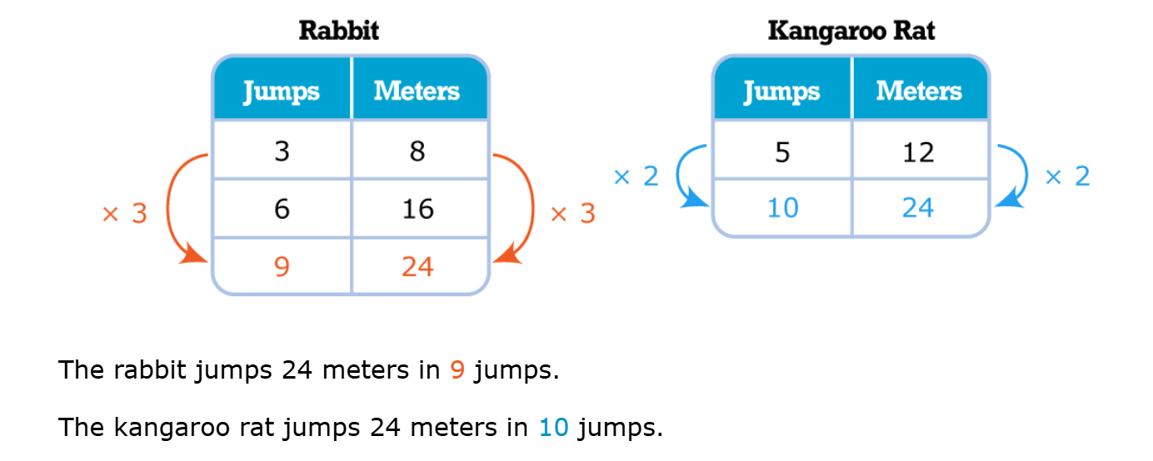
RATIO
Lesson Objective: I will be able to compute unit rates involving ratios of fractions by dividing and simplifying fractions.
SC : I can write a ratio of fractions as a complex fraction.
SC : I can divide fractions to find the unit rate
UAE LINK : Find examples of unit rates in UAE.
ATL SKILLS : COMMUNICATION
IB LEARNER PROFILE : COMMUNICATOR
Keywords: Ratio, unit rate, reciprocal, simplify

Slide 22
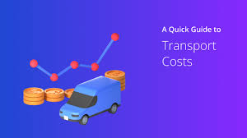


RATIO
Lesson Objective: I will be able to compute unit rates involving ratios of fractions by dividing and simplifying fractions.
SC : I can write a ratio of fractions as a complex fraction.
SC : I can divide fractions to find the unit rate.
UAE LINK : Find examples of unit rates in UAE.
Real-life task: Find 3 examples of unit rates
in UAE (from grocery flyers, transport fares,
or online shopping). Explain which is the better deal.
ATL SKILLS : COMMUNICATION
IB LEARNER PROFILE : COMMUNICATOR
Keywords: Ratio, unit rate, reciprocal, simplify

Slide 23
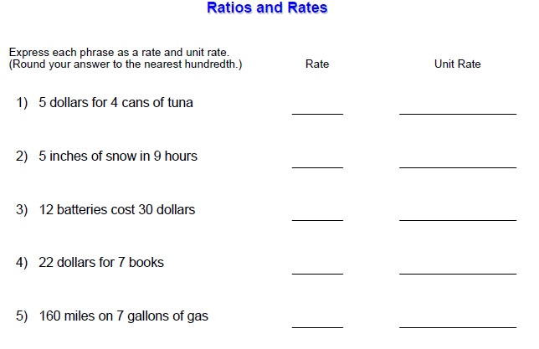

RATIO
Lesson Objective: I will be able to compute unit rates involving ratios of fractions by dividing and simplifying fractions.
SC : I can write a ratio of fractions as a complex fraction.
SC : I can divide fractions to find the unit rate.
UAE LINK : Find examples of unit rates in UAE.
EXIT TICKETS
ATL SKILLS : COMMUNICATION
IB LEARNER PROFILE : COMMUNICATOR
Keywords: Ratio, unit rate, reciprocal, simplify

Slide 24


RATIO
Lesson Objective: I will be able to apply unit rates to solve and explain real-life problems involving quantities with like or different units.
SC : I can simplify the unit rate to its simplest form.
SC : I can interpret the unit rate in the context of a real-life problem
UAE LINK : Word problems involving UAE tourism.
Teacher Link: https://wayground.com/admin/activity/classic/68ec9983a11332e06972ab70
ATL SKILLS : COMMUNICATION
IB LEARNER PROFILE : COMMUNICATOR
Keywords: Ratio, unit rate, reciprocal, simplify

Slide 25
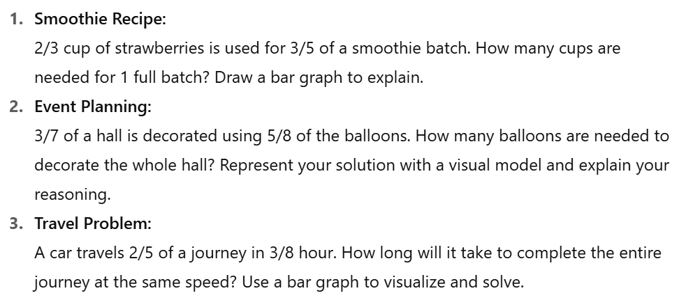
RATIO
Lesson Objective: I will be able to apply unit rates to solve and explain real-life problems involving quantities with like or different units.
SC : I can simplify the unit rate to its simplest form.
SC : I can interpret the unit rate in the context of a real-life problem
UAE LINK : Word problems involving UAE tourism.
ASPIRE
GROW
SUCCEED
ATL SKILLS : COMMUNICATION
IB LEARNER PROFILE : COMMUNICATOR
Keywords: Ratio, unit rate, reciprocal, simplify

Slide 26
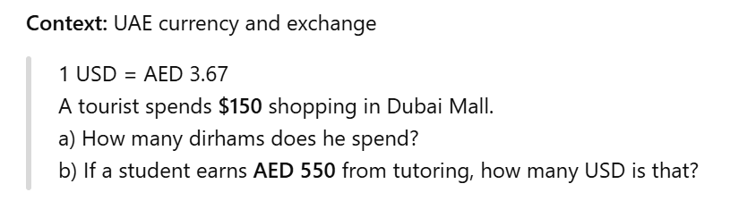
RATIO
Lesson Objective: I will be able to apply unit rates to solve and explain real-life problems involving quantities with like or different units.
SC : I can simplify the unit rate to its simplest form.
SC : I can interpret the unit rate in the context of a real-life problem
UAE LINK : Word problems involving UAE tourism.
UAE CONNECTION
ATL SKILLS : COMMUNICATION
IB LEARNER PROFILE : COMMUNICATOR
Keywords: Ratio, unit rate, reciprocal, simplify

Slide 27
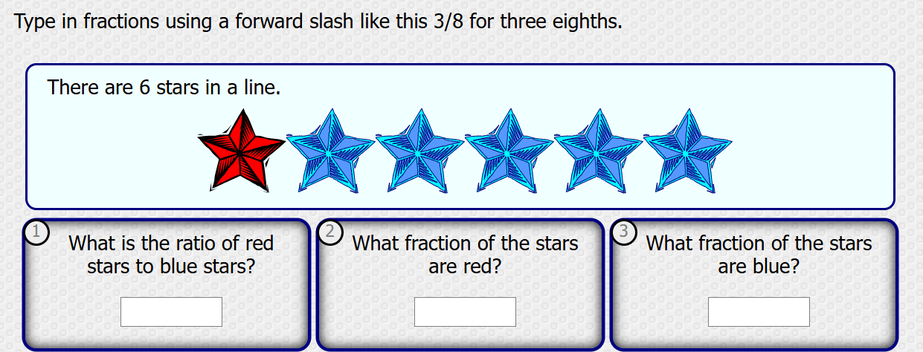
RATIO
Lesson Objective: I will be able to apply unit rates to solve and explain real-life problems involving quantities with like or different units.
SC : I can simplify the unit rate to its simplest form.
SC : I can interpret the unit rate in the context of a real-life problem
UAE LINK : Word problems involving UAE tourism.
TASK 1 – KNOWLEDGE (ASPIRE)
ATL SKILLS : COMMUNICATION
IB LEARNER PROFILE : COMMUNICATOR
Keywords: Ratio, unit rate, reciprocal, simplify

Slide 28
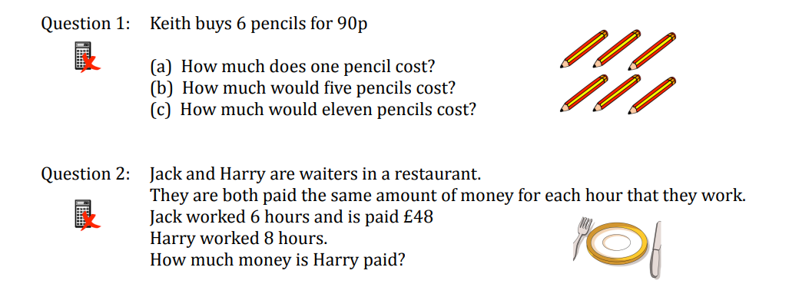
RATIO
Lesson Objective: I will be able to apply unit rates to solve and explain real-life problems involving quantities with like or different units.
SC : I can simplify the unit rate to its simplest form.
SC : I can interpret the unit rate in the context of a real-life problem
UAE LINK : Word problems involving UAE tourism.
TASK -2 APPLICATION (GROW)
ATL SKILLS : COMMUNICATION
IB LEARNER PROFILE : COMMUNICATOR
Keywords: Ratio, unit rate, reciprocal, simplify

Slide 29
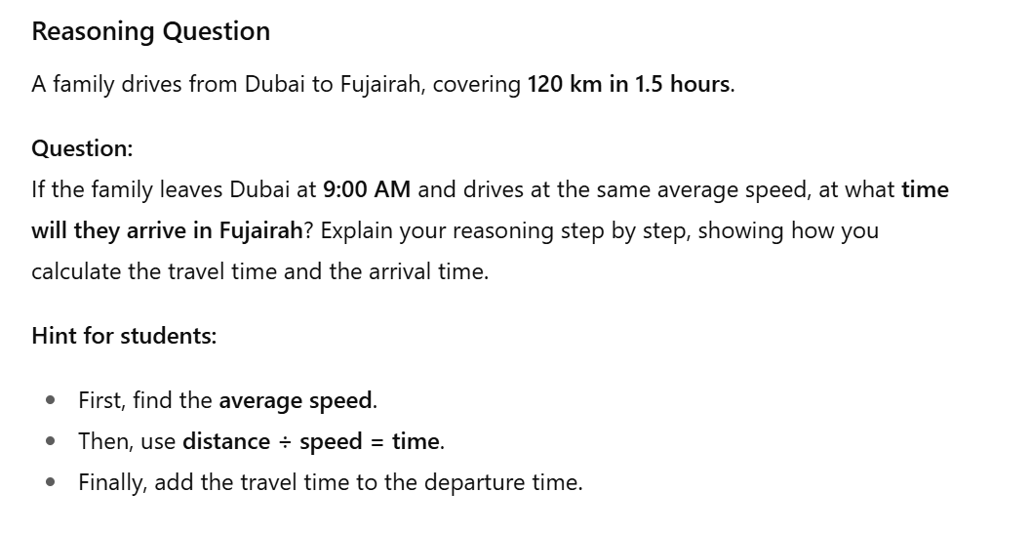
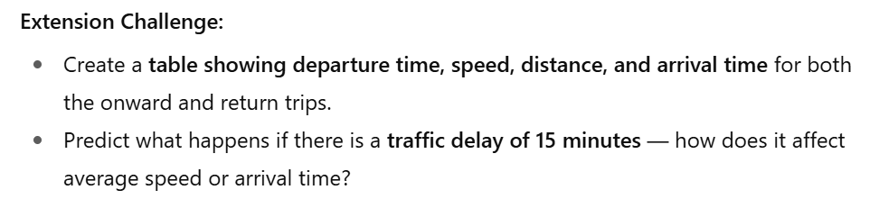
RATIO
Lesson Objective: I will be able to apply unit rates to solve and explain real-life problems involving quantities with like or different units.
SC : I can simplify the unit rate to its simplest form.
SC : I can interpret the unit rate in the context of a real-life problem
UAE LINK : Word problems involving UAE tourism.
TASK -3 REASONING (SUCCEED)
ATL SKILLS : COMMUNICATION
IB LEARNER PROFILE : COMMUNICATOR
Keywords: Ratio, unit rate, reciprocal, simplify

Slide 30
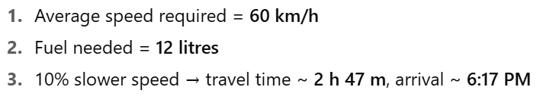
RATIO
Lesson Objective: I will be able to apply unit rates to solve and explain real-life problems involving quantities with like or different units.
SC : I can simplify the unit rate to its simplest form.
SC : I can interpret the unit rate in the context of a real-life problem
UAE LINK : Word problems involving UAE tourism.
ANSWERS
ATL SKILLS : COMMUNICATION
IB LEARNER PROFILE : COMMUNICATOR
Keywords: Ratio, unit rate, reciprocal, simplify

Slide 31
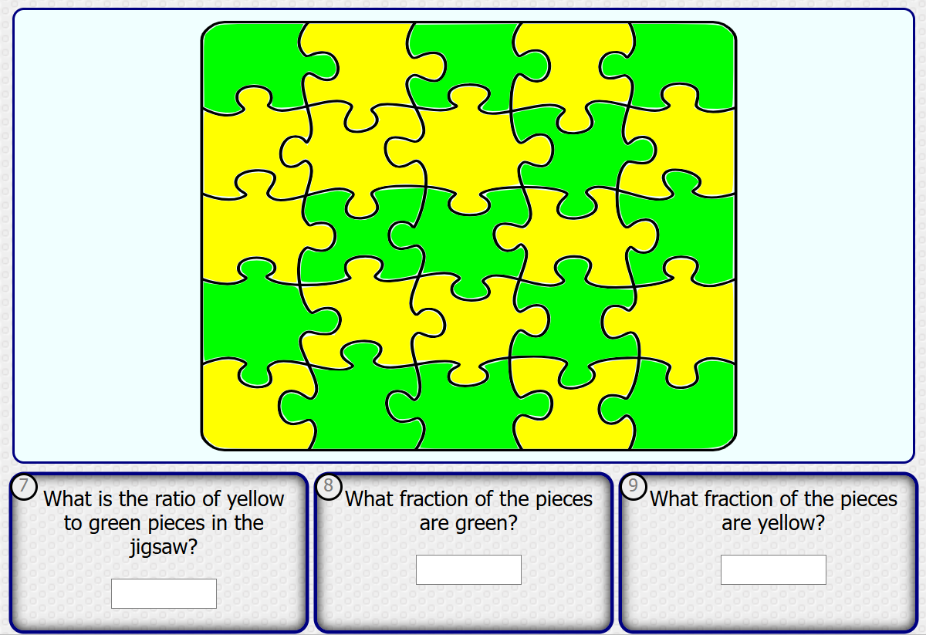
RATIO
Lesson Objective: I will be able to apply unit rates to solve and explain real-life problems involving quantities with like or different units.
SC : I can simplify the unit rate to its simplest form.
SC : I can interpret the unit rate in the context of a real-life problem
UAE LINK : Word problems involving UAE tourism.
ATL SKILLS : COMMUNICATION
IB LEARNER PROFILE : COMMUNICATOR
Keywords: Ratio, unit rate, reciprocal, simplify

